Slide 1
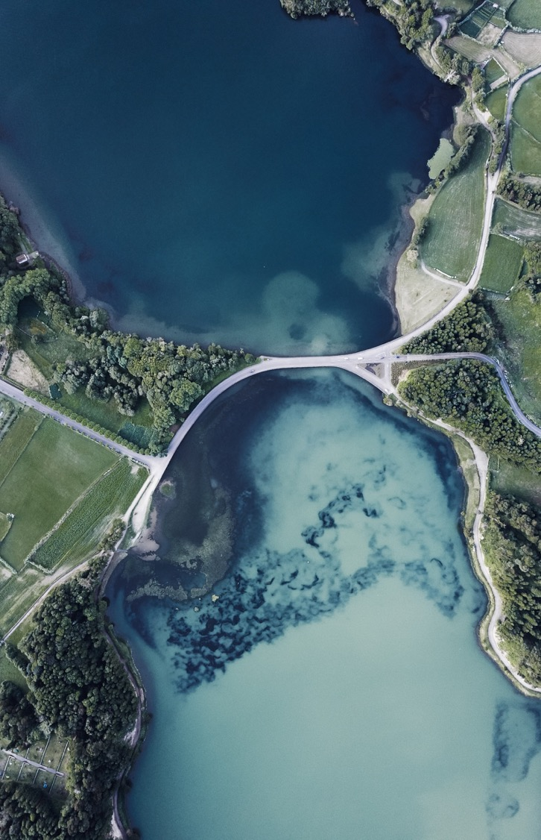
Open A restaurant in seattle

Slide 2
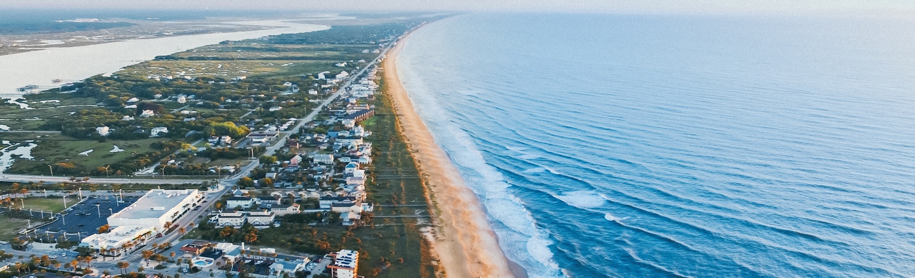
Introductory
To open a restaurant in Seattle, it's crucial to understand where to locate. Competition study is an important benchmark. We would need to learn how to stand up among so many competitors, then set up a marketing plan for our restaurant. Via this study, we would find the density of the restaurant around Pike Fish Market and different categories of restaurants nearby.
Your company name

Slide 3
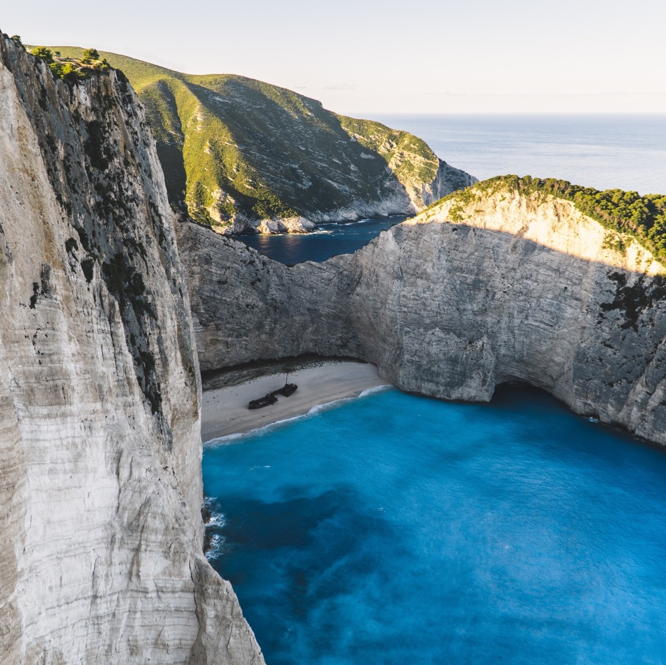
Data
We would use Foursquare API to obtain location data to find out all restaurant in Seattle. From those locations, we could identify the main activities area.
To find the optimal location, we analyze the cuisine available in Seattle. Observing the density of competitors, we would decide to select a location in CBD or residential area.
Your company name

Slide 4

Methodology
Pike Fish Market is a tourist spot. I expect that is the high traffic area. Hence, I used Foursquare to geocode the location of it as the origin to identify other competitors.
Then, I used search word ‘restaurant’ to call 30 restaurants within 500 radius of Pike Fish Market using Foursquare API. After request the data, useful columns set into data frame for further analysis.
Your company name

Slide 5
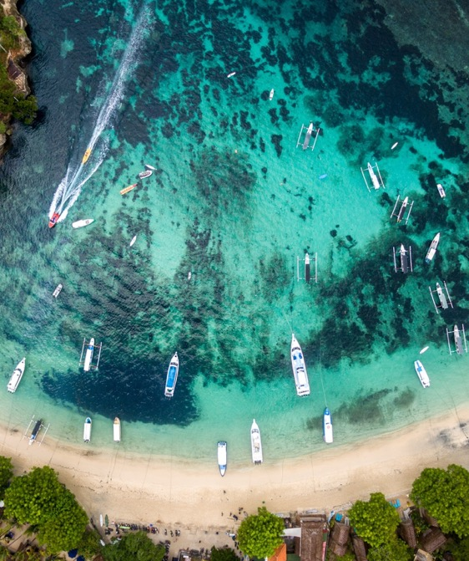
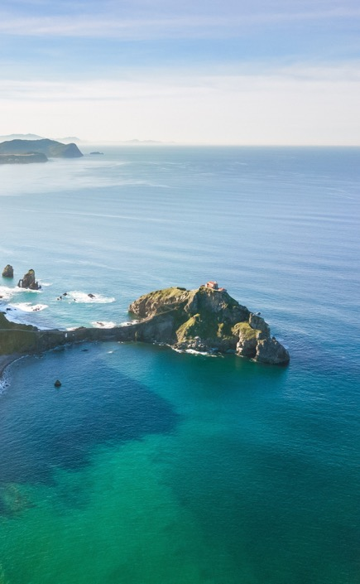
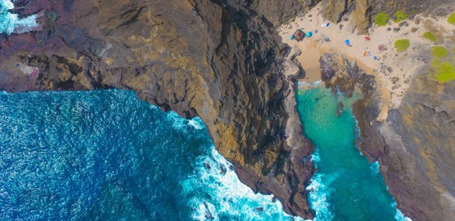
Methodology
To understand how categories available in the dataset, the 30 places would be grouped and counted in a summary. I found there’s 17 categories of restaurant. Then, a dummy column is created based on the 17 categories for map visualization.
For better visualization, I had created a map which each color represent the type of restaurant, example: red represent seafood restaurant using the dummy column previously created.
Your company name

Slide 6
Results
From the summary, around 35% (6 restaurants) are seafood restaurants and most of it are nearby the seaside. There’s a lot of Asian culture restaurant like Thai restaurant, Vietnamese restaurant, nearby the Pike Fish Market. However, most of them are distance from seaside.
categories | count | Percentage (%)
Seafood Restaurant | 6 | 35.294118
Vietnamese Restaurant | 3 | 17.647059
Thai Restaurant | 3 | 17.647059
Restaurant | 3 | 17.647059
Food | 2 | 11.764706
French Restaurant | 2 | 11.764706
Mexican Restaurant | 1 | 5.882353
Sushi Restaurant | 1 | 5.882353
Pub | 1 | 5.882353
Breakfast Spot | 1 | 5.882353
Lounge | 1 | 5.882353
Chinese Restaurant | 1 | 5.882353
Irish Pub | 1 | 5.882353
Hotel Bar | 1 | 5.882353
Financial or Legal Service | 1 | 5.882353
Cocktail Bar | 1 | 5.882353
Italian Restaurant | 1 | 5.882353
Your company name

Slide 7
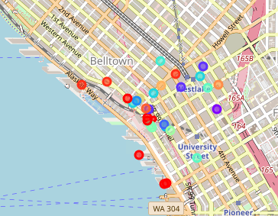
Results
From this map, I observed that there’s high density of restaurant nearby Pike Fish Market. Most of them are seafood restaurant or western style restaurant, like French style restaurant.
Your company name

Slide 8
Discussion
From the analysis, I would recommend to open the restaurant based on category. If we choose to open a seafood restaurant, seaside would be a good location, however, there’s a lot of rivals.
If we choose an Asian style restaurant, further location study are required because most of them are opened far from the seaside and Pike Fish Market. There’s not much of Asian style restaurant open nearby Pike Fish Market.
If the target customer prefer tried out Asian Food, open a restaurant close to Pike Fish Market, it won’t be a bad idea. However, we might need more effort to outstanding among the competitors around Pike Fish Market.

Slide 9
Conclusion
Through this capstone project, I learnt how to use Foursquare API to obtain location information for analysis. Also, it’s help build up a better judgement to perform an analysis.
From the analysis, I conclude that there’s a lot of competitors around Pike Fish Market. To be competitive, person who interested to open a restaurant around that area should learn the target customers and try hard to outstand among different categories restaurant.

Slide 10

Thank You

